Slide 1
Report: „Example of a user-friendly and inconvenient interface“
Made by pi18e student
Džiugas pečiulevičius

Slide 2
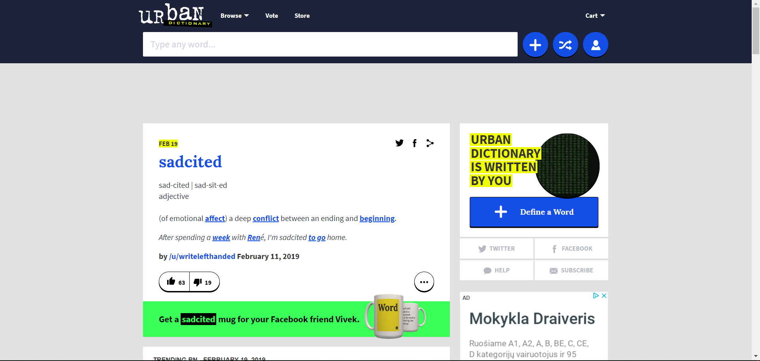
EXAMPLE OF AN INCONVENIENT INTERFACE: https://www.urbandictionary.com/

Slide 3
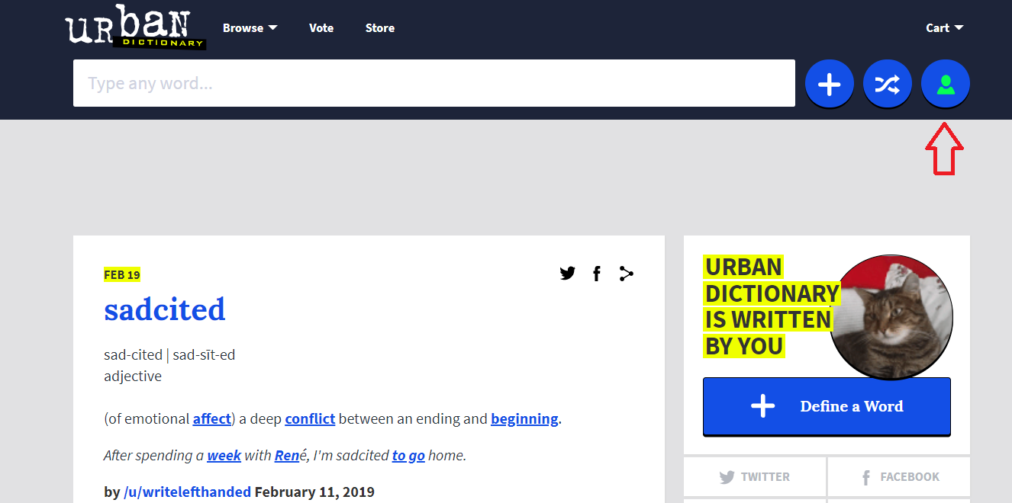
Logging in / Registering to the website

Slide 4
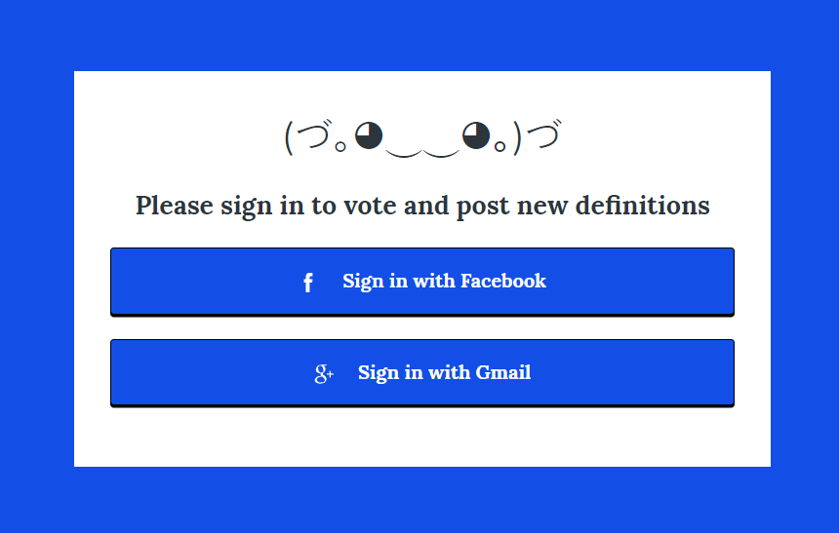
Apparently, it only allows us to log-in with either our Google or Facebook accounts just as shown.

Slide 5
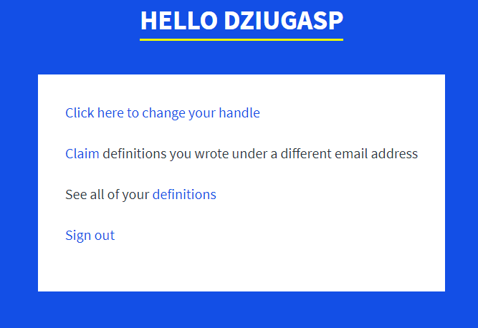
After logging in, the page doesn‘t change at all from how it looked back in, so it is really hard to tell if you‘re logged in or not. When clicked on the ‘Log-in‘ button, there‘s not much you can do

Slide 6
1st page log-in Usability principles
Poorly executed principles:
Learnability (Familiarity - The log in networking buttons are not in the usual location. Consistency – All the buttons are not in their usual location so it’s hard for the user to remember the location of all then buttons on this page.)
Robustness (Task Confirmation – It doesn’t ask for any confirmation when clicking on anything, even when registering or logging in.)

Slide 7
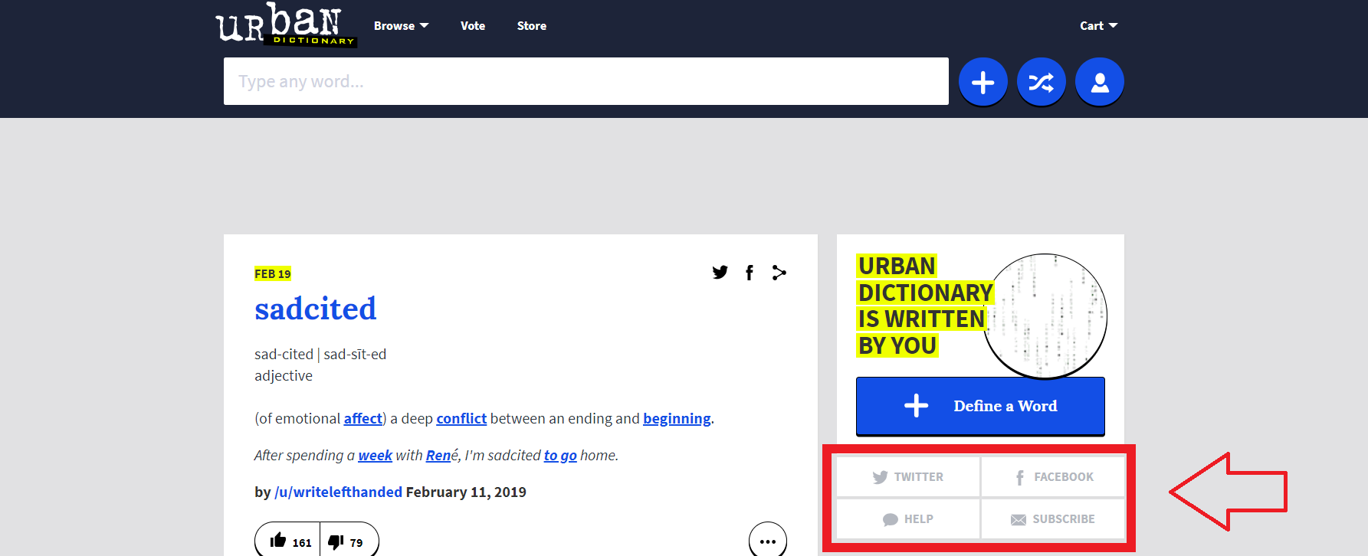
To make a page simple and usable for a user it would be a good idea to put all the networking information to either very top of the page or put it at the very bottom of the page (called footer).

Slide 8
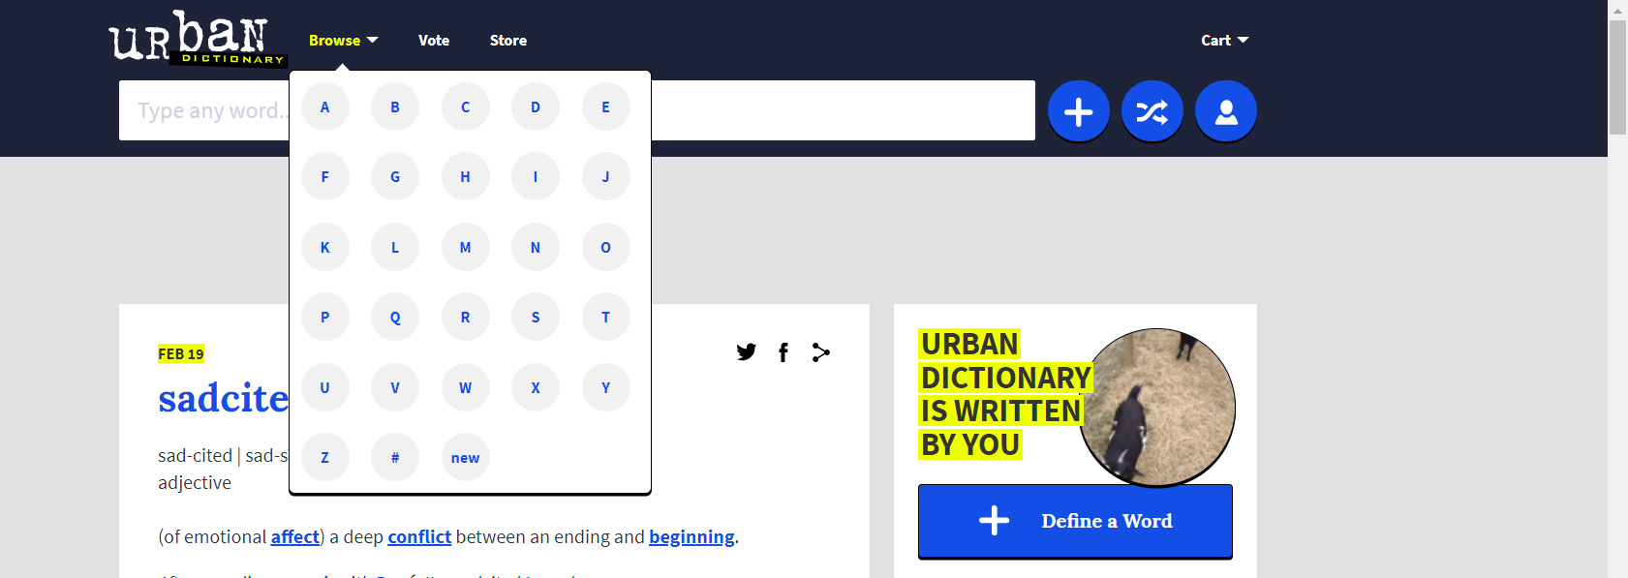
‘Browse’ button is really not that effective and lacks Substitutivity* which allows a user to choose suitable interaction method.
Because it only gives us a drop-down menu of many letters and there’s no actual search function which is pretty inconvenient.
*Substitutivity is flexibility in details of operations.

Slide 9
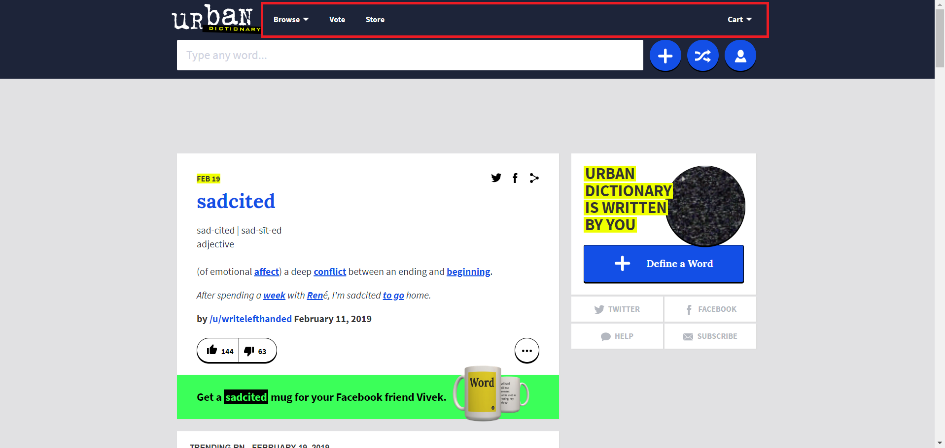
On the left of a ‘Store’ button we could see a ‘Vote’ button and I’m not quite sure what it does, because the website is asking me to register into the website first.

Slide 10
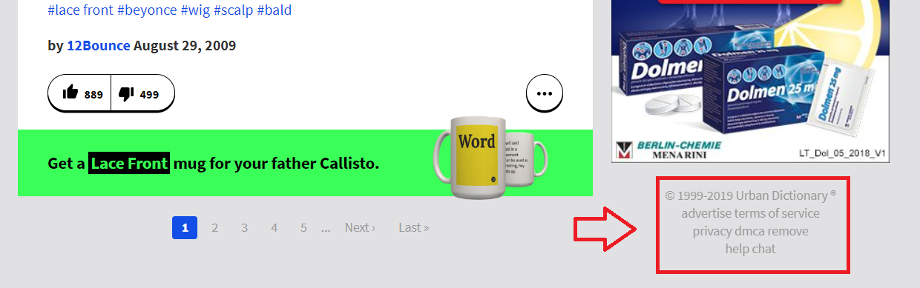
Footer should be placed at the bottom with all the links that are not being visited frequently, and make it static so it stays at the bottom of the screen and doesn’t move while you scroll through the page.

Slide 11
1st page visual Usability principles
Poorly executed principles:
Flexibility (Substitutivity – it doesn’t give us many options to input a word for example. Customizability – there’s no way to edit user interface.)

Slide 12
1ST WEBPAGE REFLECTIONS
Website is inconsistent, confusing and difficult to use. It’s pretty hard to find the log in system. This could be easily solved by probably making 3 different buttons for registering, logging in and registering an account. This would make it easy to remember where everything related to the profile can be found.

Slide 13
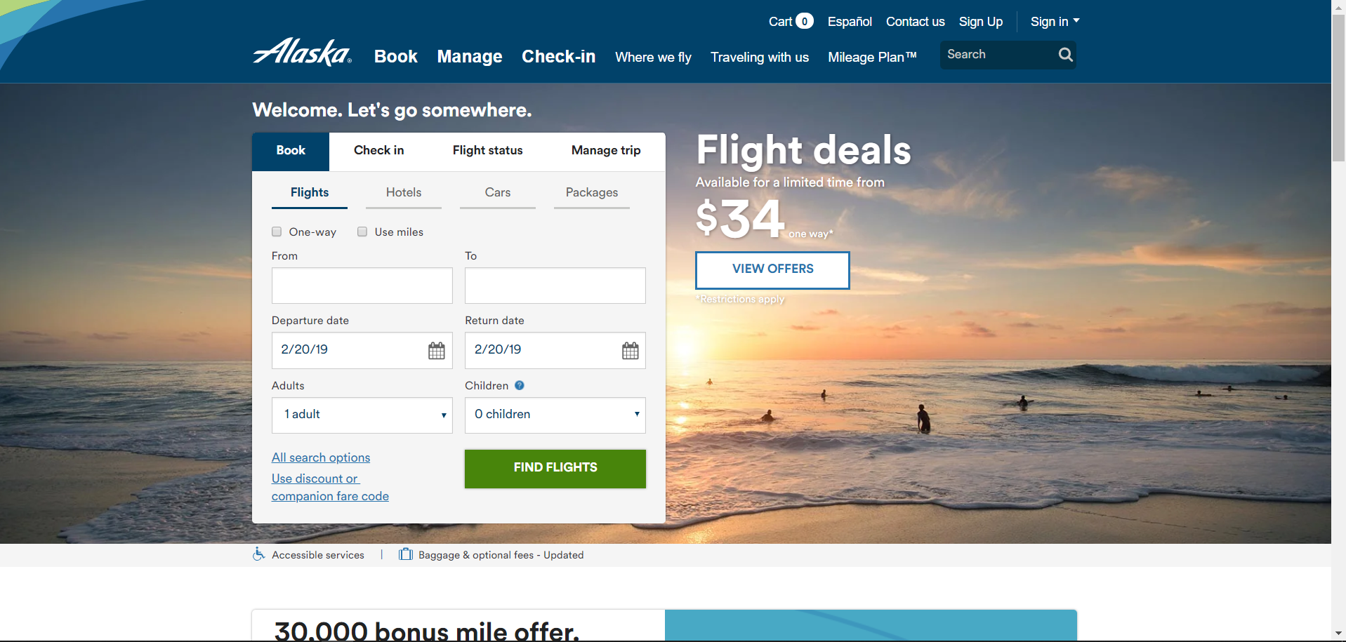
EXAMPLE OF A USER-FRIENDLY INTERFACE:
https://www.alaskaair.com/

Slide 14
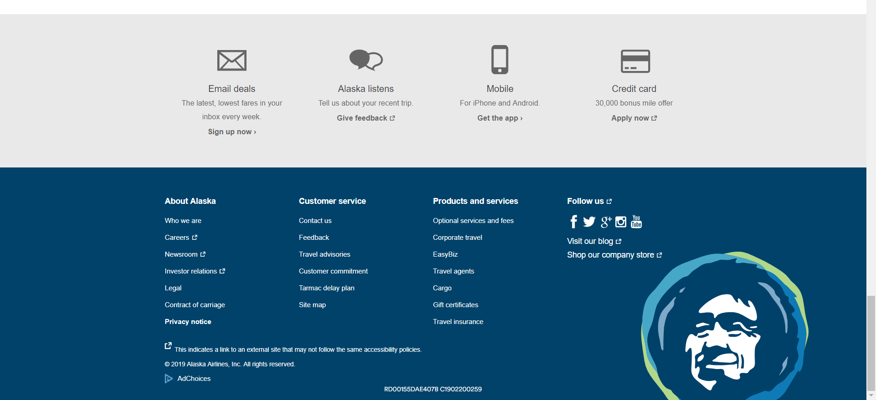
Footer page

Slide 15
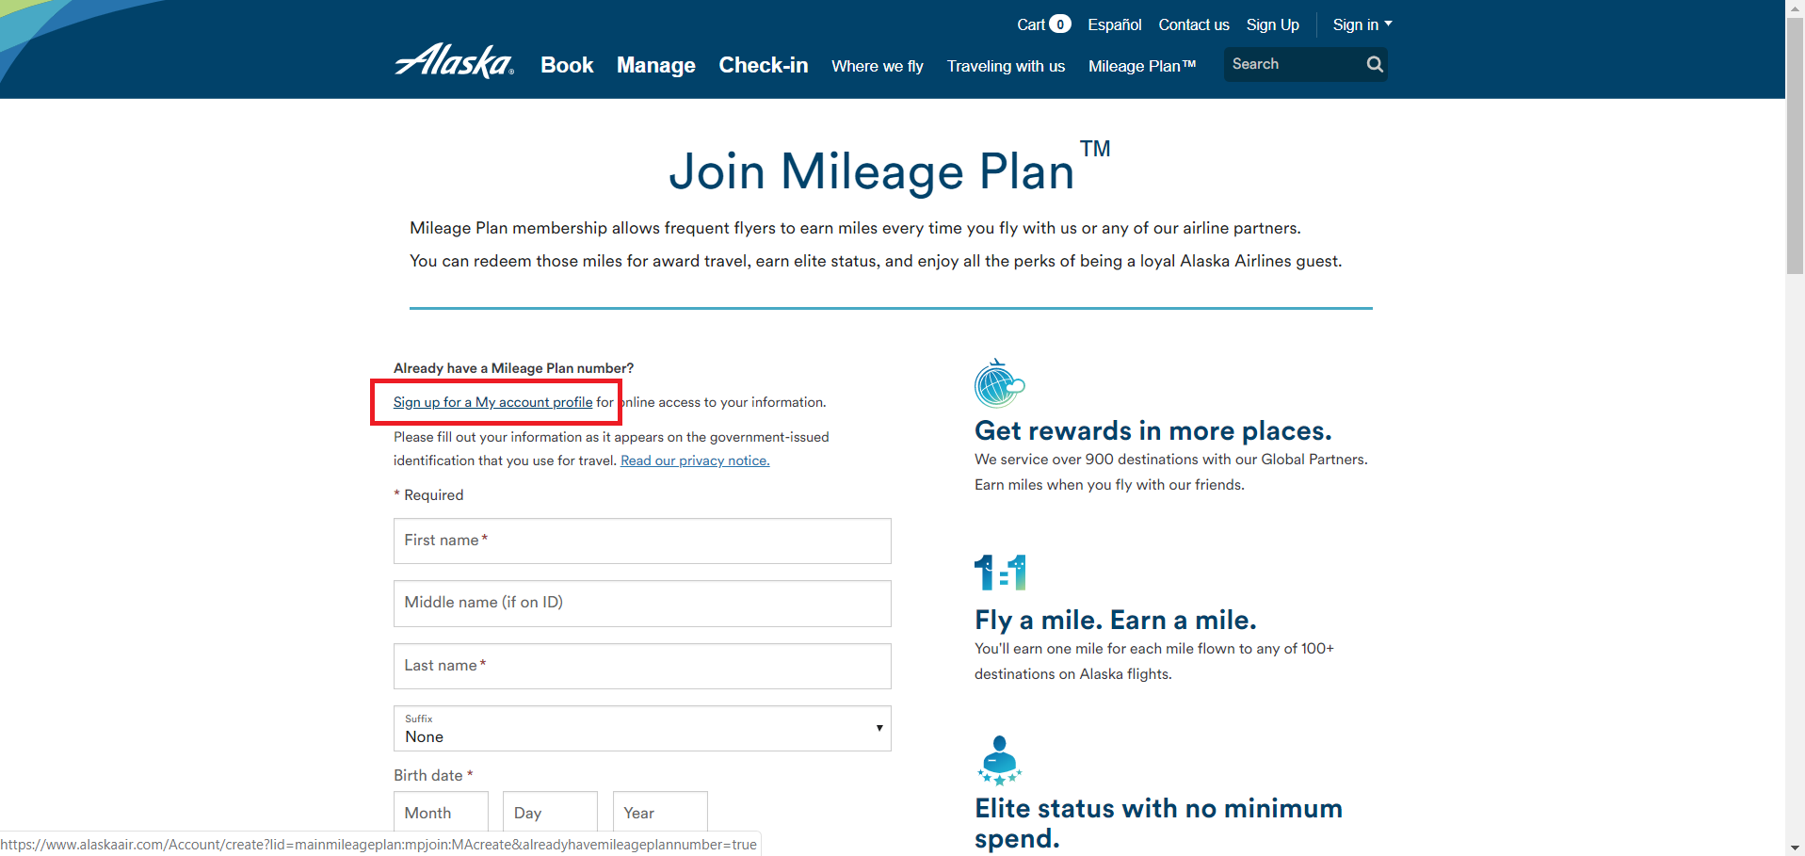
To register, you will need to click on Sign-Up and then on ‘Sign up for a My account profile’

Slide 16
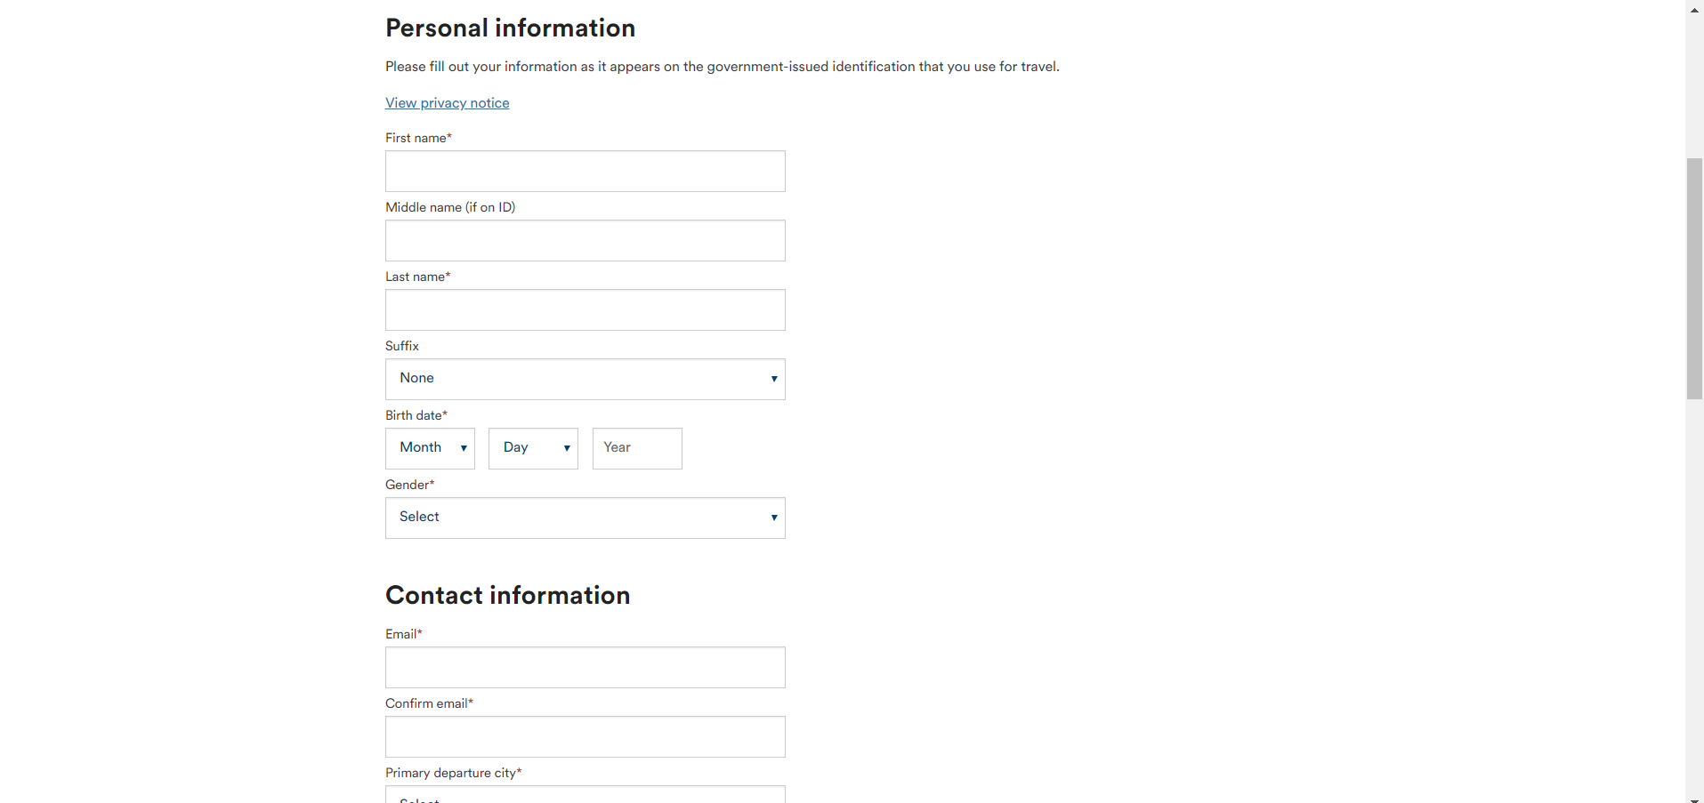
Fill in information to create an account

Slide 17
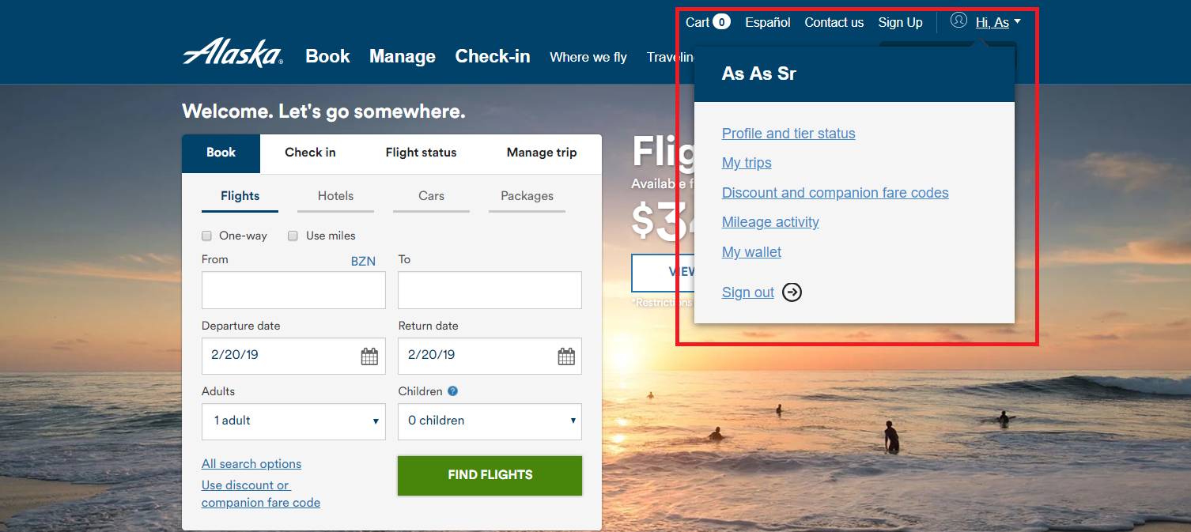
You can access your account right from the main page

Slide 18
2nd page Usability principles
Poorly executed principles:
Learnability (Synthesizability – Had problems registering an account. After clicking on ‘create an account’ it kept bringing me to a white screen with no error messages.)
Robustness (Recoverability – did not get any messages helping me to resolve an error with registering an account.)

Slide 19
Reflections
When designing the interface it was overlooked that the users would have to click few times to bring them a registration form. This can easily be solved by either by just bringing the main registering form after a users clicks on a ‘Sign-up‘ button.

